Slide 1
Screenshot Collections
HP0G48 IT in Business: Advanced Database
22IT Zhang Wuzhuohao

Slide 2
Table of Contents
P03: Data Table: cars
P04: Data Table: customers
P05: Data Table: salesperson
P06: Data Table: orders
P07: Query (make-table) design: Customer Info by Car Make
P08: Query (make-table) results: Customer Info by Car Make
P09: Query (parameter) design: Customer Info by Salesperson
P10: Query (parameter) results: Customer Info by Salesperson
P11: Query (calculation) design: Commission by Order
P12: Query (calculation) results: Commission by Order
P13: Query (total) design: Commission by Salesperson
P14: Query (total) results: Commission by Salesperson
P15: Form: Order System
P16: Switchboard

Slide 3
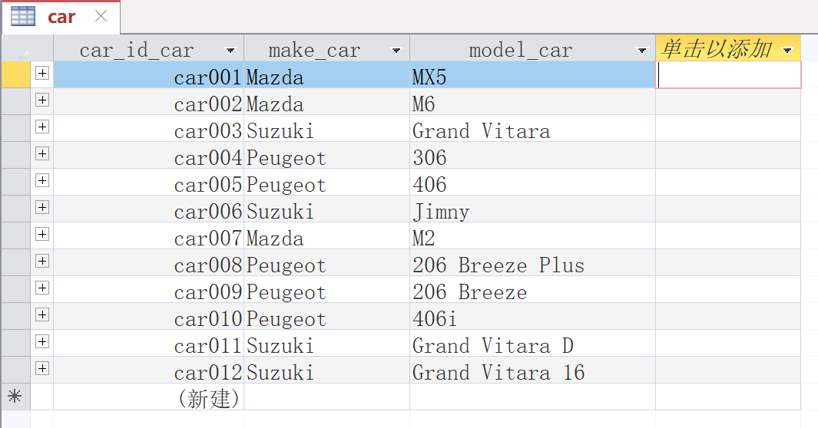
Data Table: cars

Slide 4
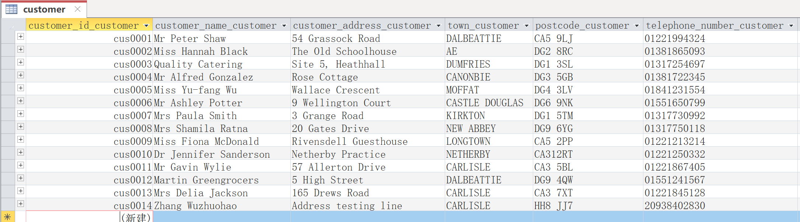
Data Table: customers

Slide 5
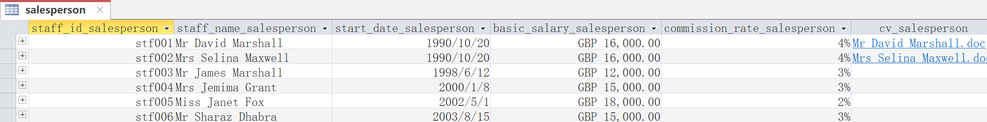
Data Table: salesperson

Slide 6
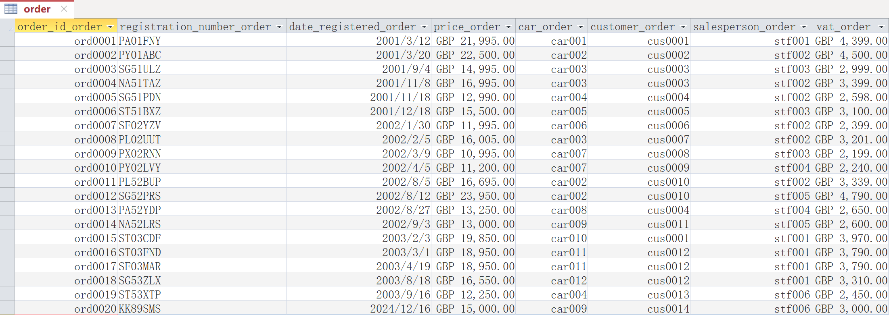
Data Table: orders

Slide 7
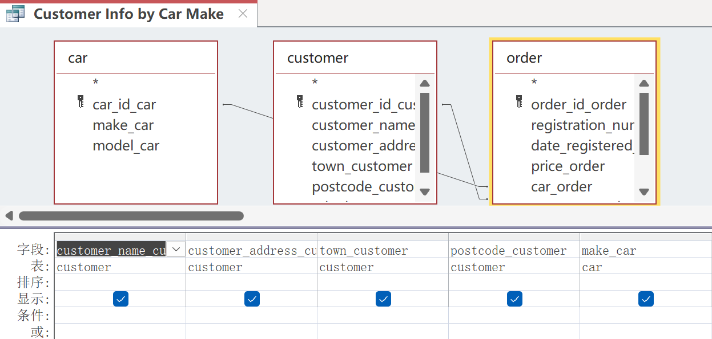
Query (make-table) design: Customer Info by Car Make

Slide 8
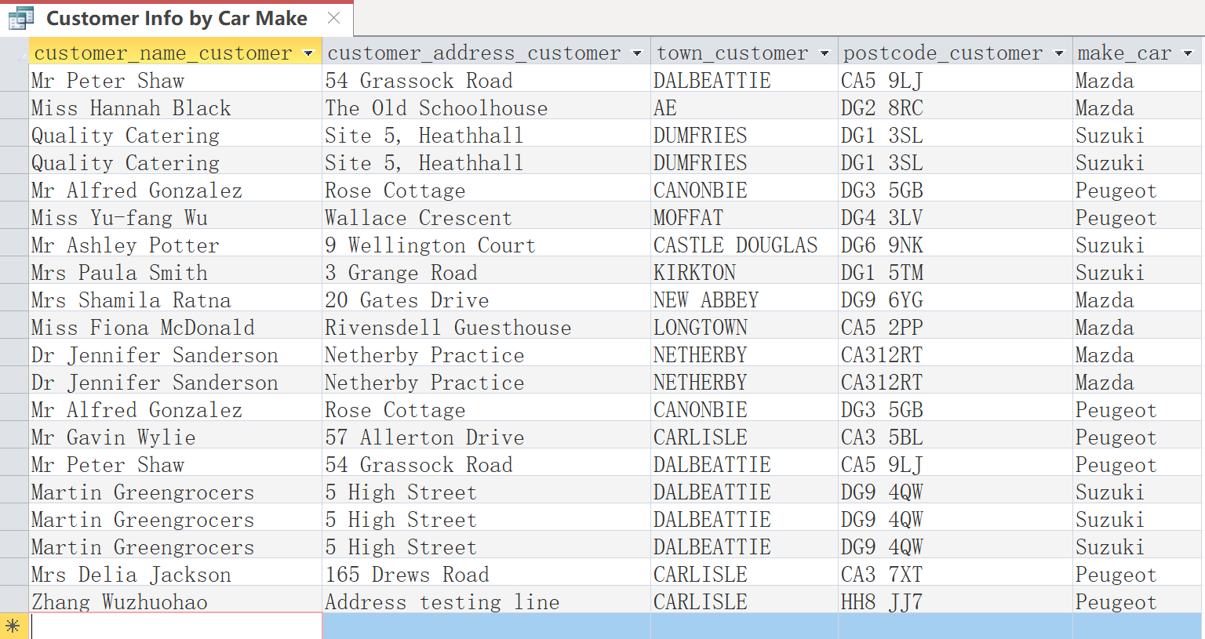
Query (make-table) results: Customer Info by Car Make

Slide 9
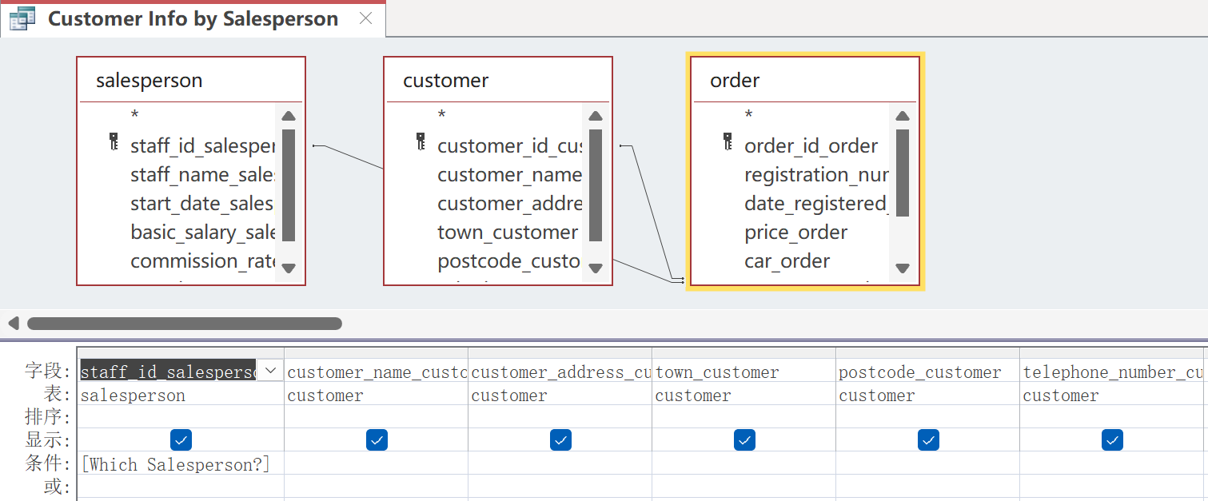
Query (parameter) design: Customer Info by Salesperson

Slide 10
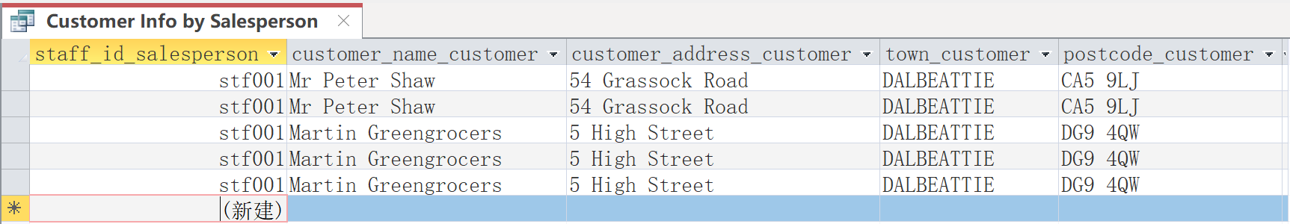
Query (parameter) results: Customer Info by Salesperson

Slide 11
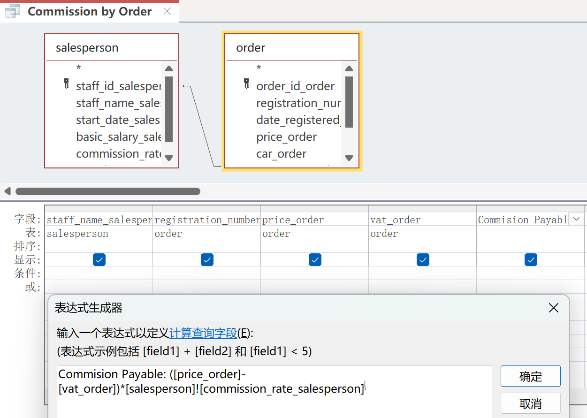
Query (calculation) design: Commission by Order

Slide 12
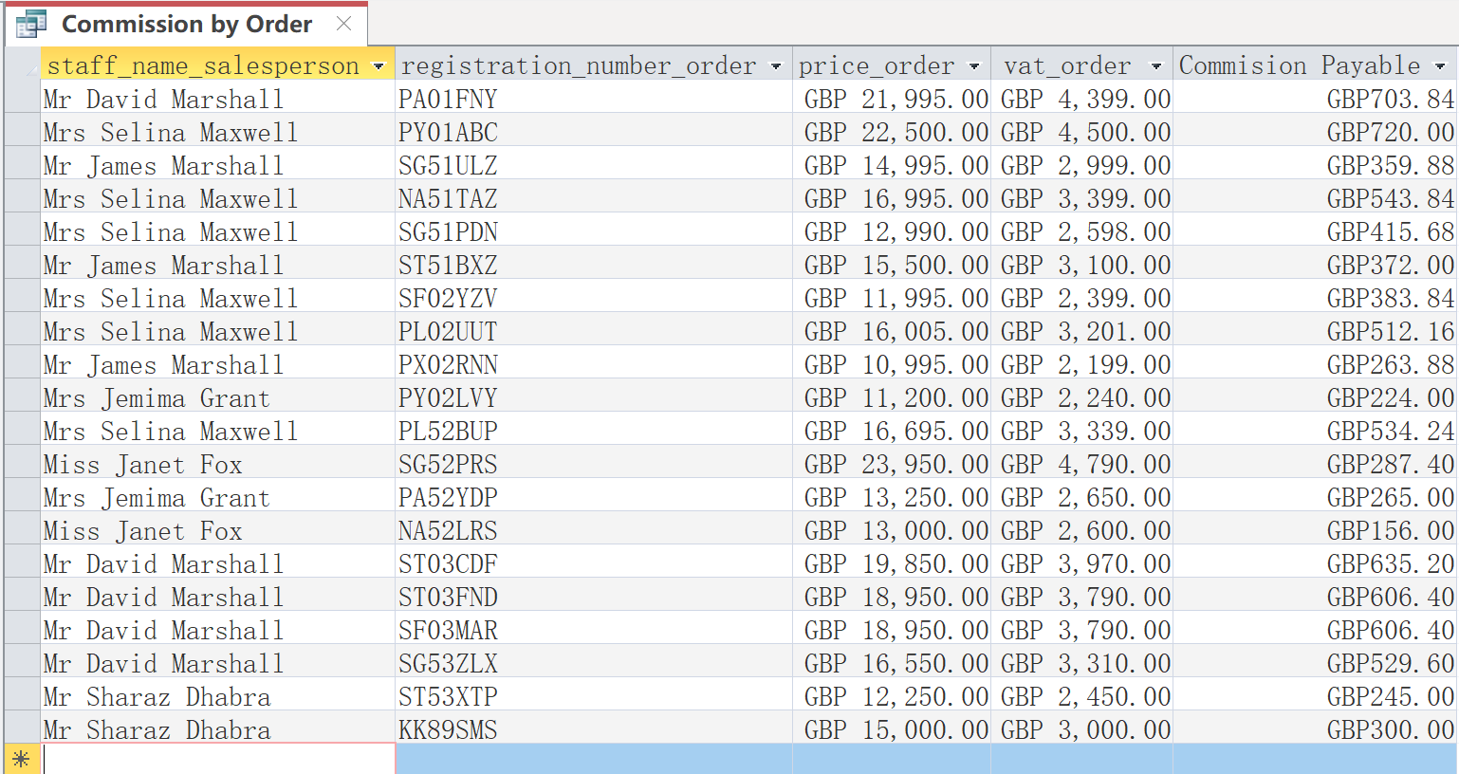
Query (calculation) results: Commission by Order

Slide 13
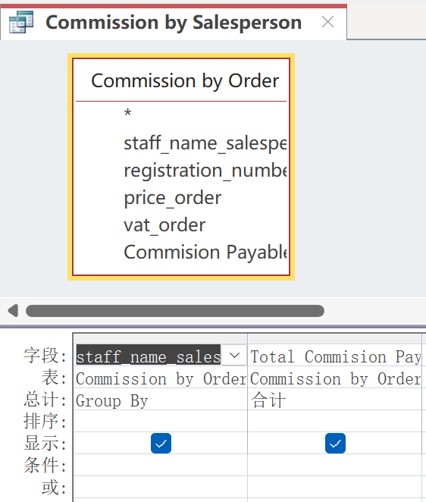
Query (total) design: Commission by Salesperson

Slide 14
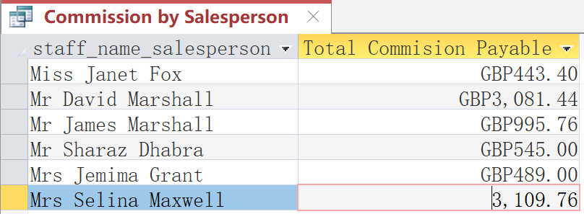
Query (total) results: Commission by Salesperson

Slide 15
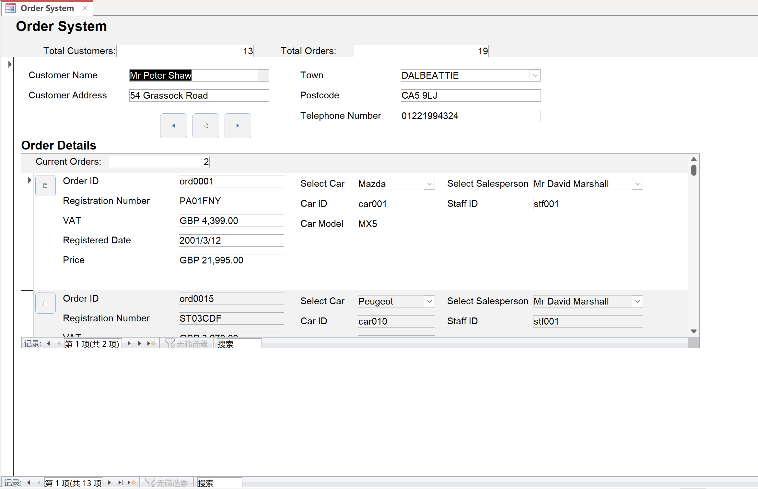
Form: Order System

Slide 16
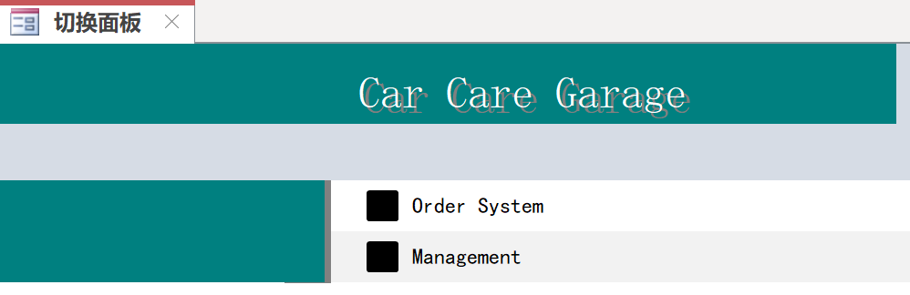
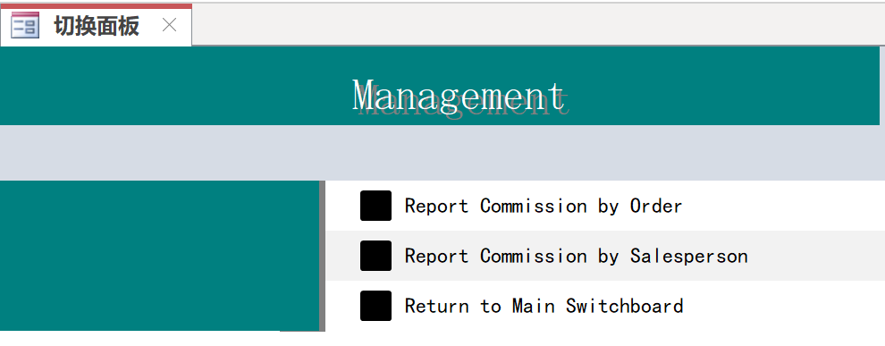
Switchboard

